Slide 1
CNN with Pytorch
and
Trail-Following
2020/12/3

Slide 2
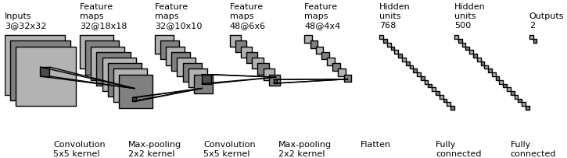
Convolution Neural Network
Architecture Overview
Convolution
3D volumes of neurons
Feature extraction
Weight sharing
Maxpooling
Subsampling
Fully connection
(1) CNN architecture
Notes:
扮演的角色
conv想像成3D神經元
後曾Conv

Slide 3
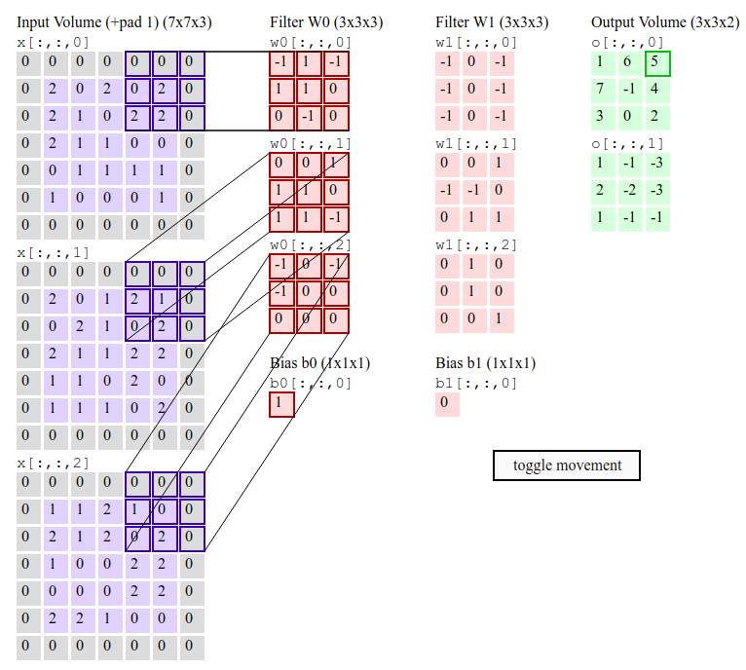
Convolution
convolution operation
source:stanford cs231n
multi-channel input

Slide 4
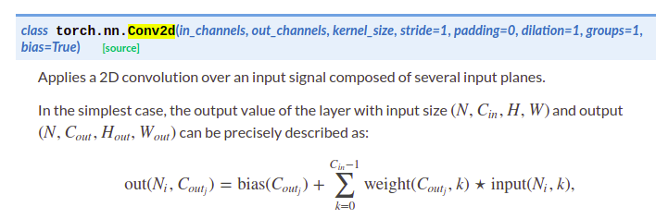
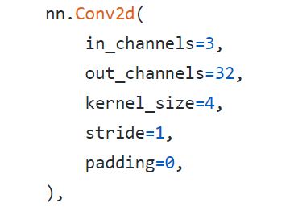
Convolution layer
p=0, s=1
torch.nn [link]
Use torch.nn module to declare convolution operation
p=1, s=1
p=1, s=2
source:stanford cs231n
Notes:
進行內積

Slide 5
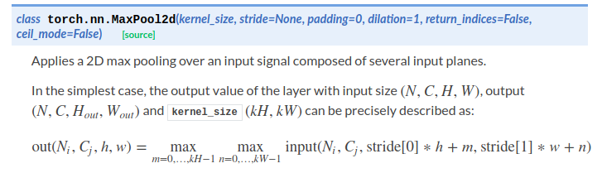
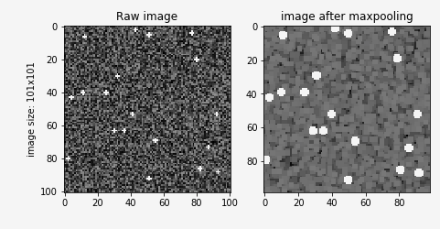
Maxpool
Downsampling without feature loss?
Code :

Slide 6
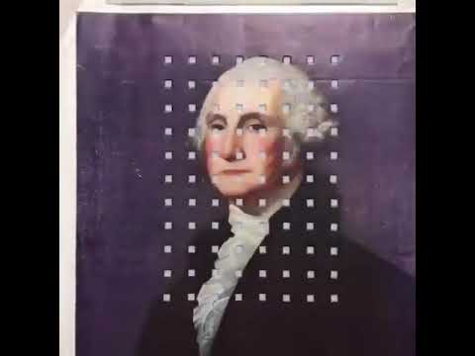
Pooling Layer

Slide 7
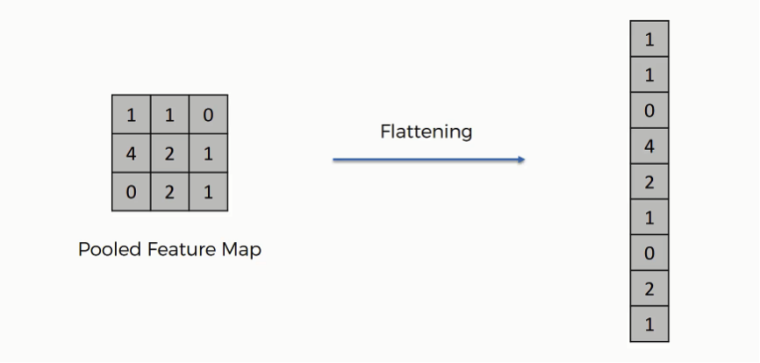
Flattern

Slide 8

Flattern
Code
flatten code 2

Slide 9

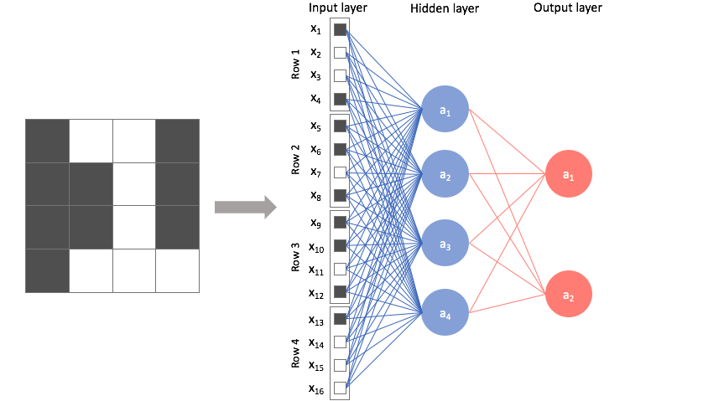
Fully connection
Features must be flatten!

Slide 10
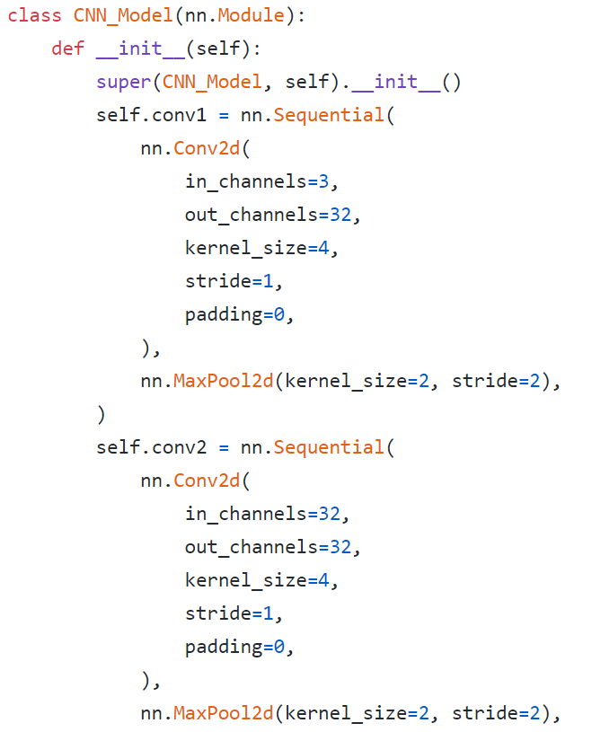
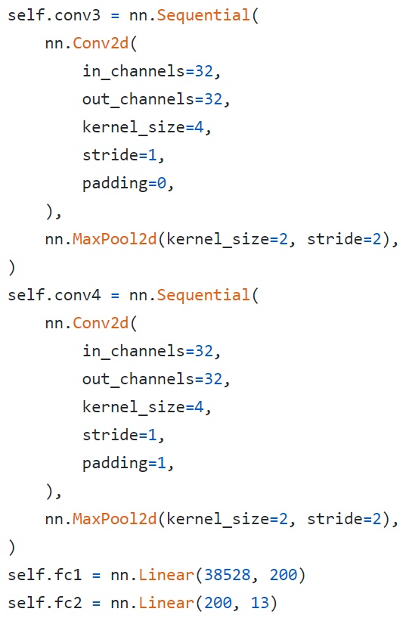
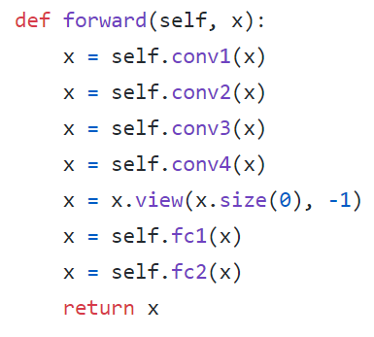
Network architecture
Review
Forward neural network

Slide 11
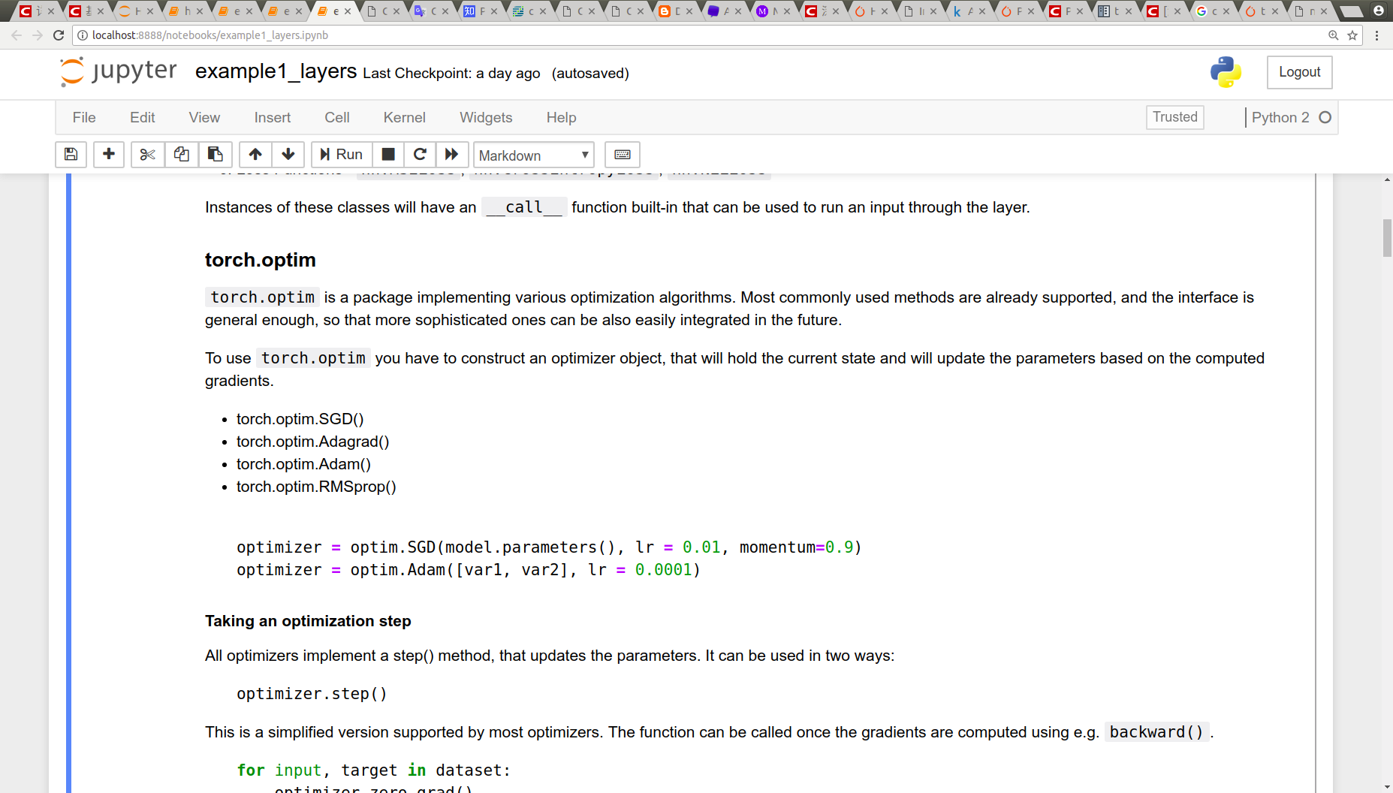
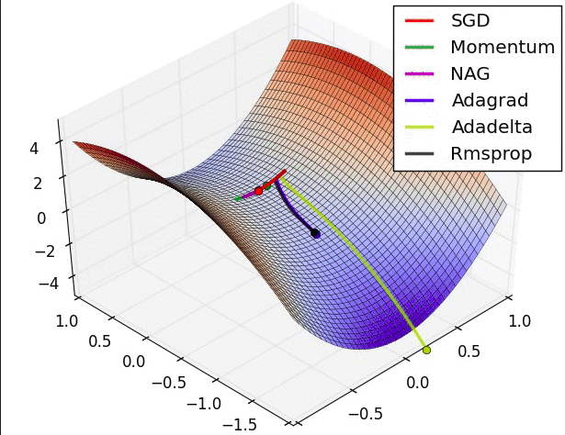
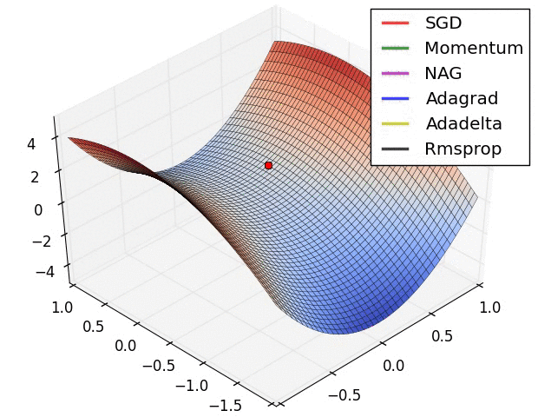
Optimizer
torch.optim [link]
Hyperparameters(learning rate, momentum of gradient descent)
loss function with weight

Slide 12

Optimizer
torch.optim
Pseudo code
Notes:
包住model parameter

Slide 13
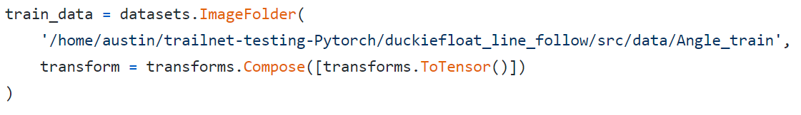
Load images as data
class torchvision.datasets.ImageFolder :
Load images from the folder and set the foldername as labels.
transforms.ToTensor() : transforms data type to tensor.
DataLoader : packaging your data for training.
洗牌

Slide 14
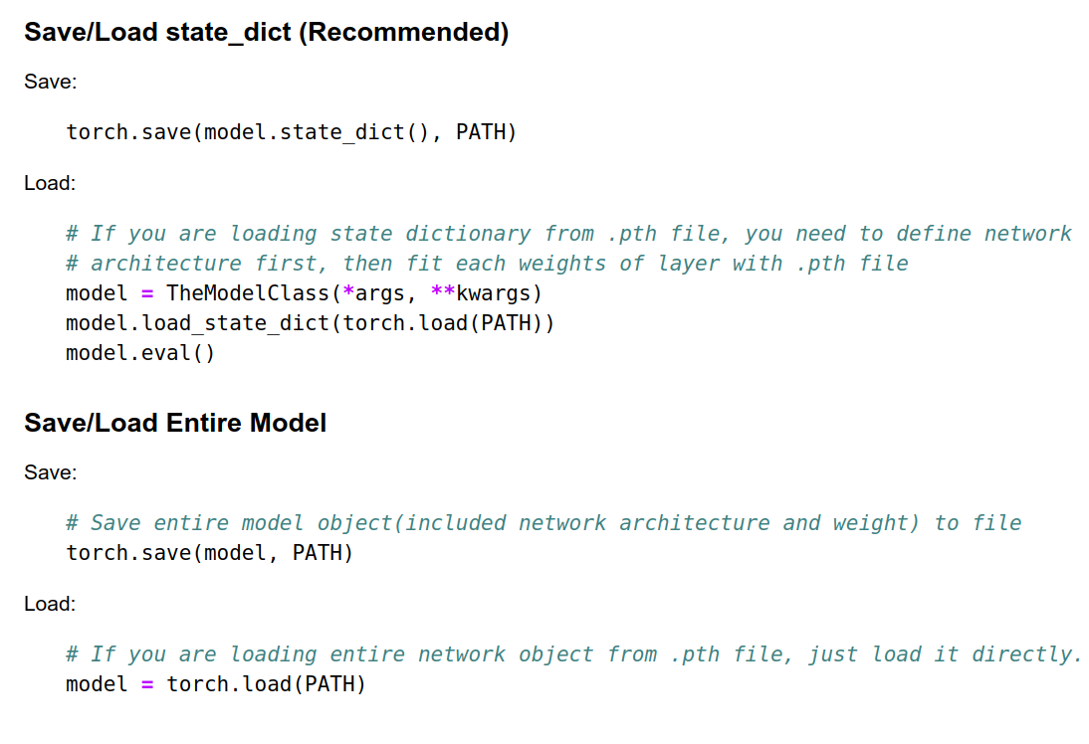
Save/ load pretrained model with Pytorch
*.pth file
Save/load state_dict
State dictionary
Save/load entire model
Entire network object
Compare this two mex

Slide 15

Today to do
Locobot trail following : use cnn model to make a prediction , predict the angle of Yellow-Blue line on the ground.

